Slide 1
Searching and Sorting in Arrays

Slide 2
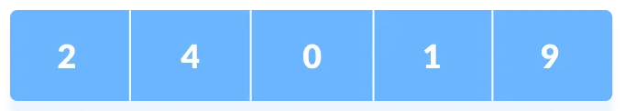
Linear Search
Linear search is a sequential searching algorithm where we start from one end and check every element of the list until the desired element is found.
It is the simplest searching algorithm.
The following steps are followed to search for an element k=1 in the list below.

Slide 3
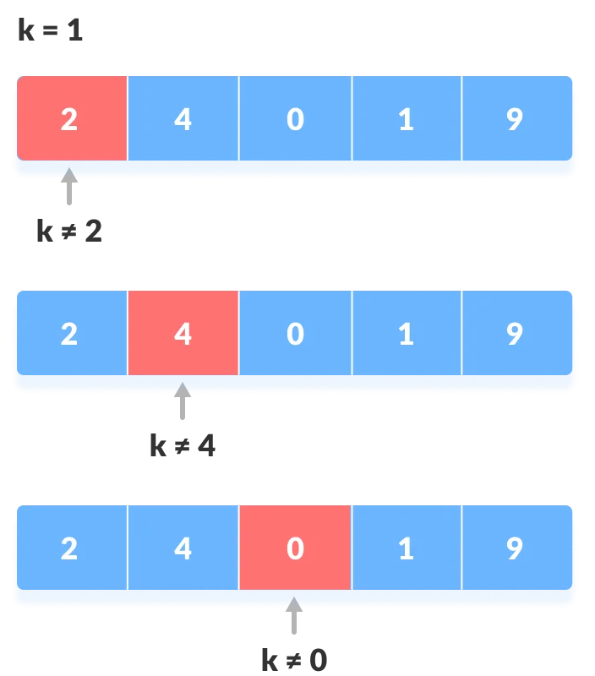
Linear Search
Start from the first element, compare k with each element of array.

Slide 4
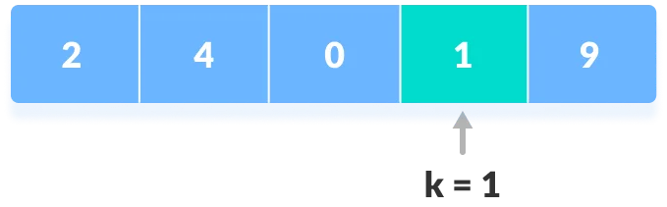
Linear Search
If x == k, return the index.
Else, return not found.

Slide 5
Binary Search
Binary Search is a searching algorithm for finding an element's position in a sorted array.
In this approach, the element is always searched in the middle of a portion of an array.
Binary search can be implemented only on a sorted list of items.
If the elements are not sorted already, we need to sort them first.

Slide 6
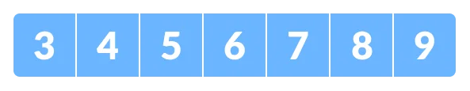
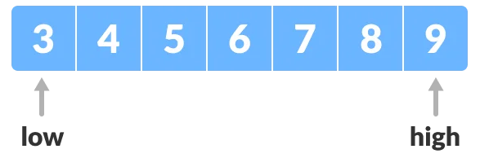
Binary Search
The array in which searching is to be performed is:
Let x=4 be the element to be searched.
Set two pointers low and high at the lowest and the highest positions respectively.

Slide 7
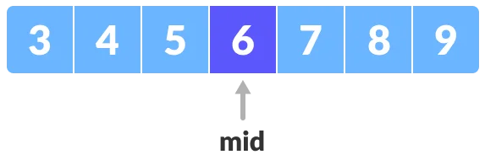
Binary Search
Find the middle element mid of the array i.e. arr[(low+high)/2] = 6
If x == mid, then return mid. Else, compare the element to be searched with other elements of array.

Slide 8
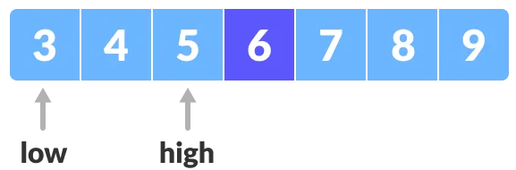
Binary Search
If x > mid, compare x with the middle element of the elements on the right side of mid. This is done by setting low to low = mid + 1;
Else, compare x with the middle element of the elements on the left side of mid. This is done by setting high to high = mid -1;

Slide 9
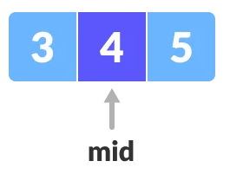
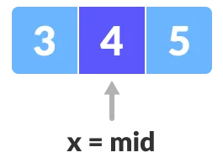
Binary Search
Repeat steps 3 to 6 until low meets high.
x = 4 is found.

Slide 10
Bubble Sort
Bubble sort is a sorting algorithm that compares two adjacent elements and swaps them until they are in the intended order.

Slide 11
Bubble Sort
Suppose we are trying to sort the elements in ascending order.
First Iteration (Compare and Swap)
Starting from the first index, compare the first and the second elements.
If the first element is greater than the second element, they are swapped.
Now, compare the second and the third elements. Swap them if they are not in order.
The above process goes on until the last element

Slide 12
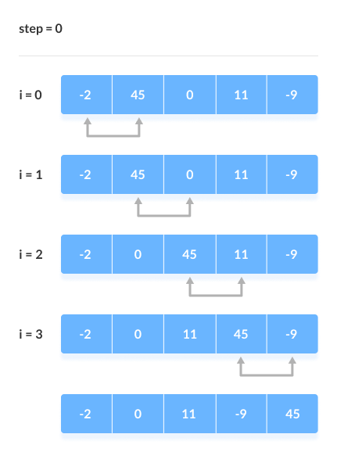
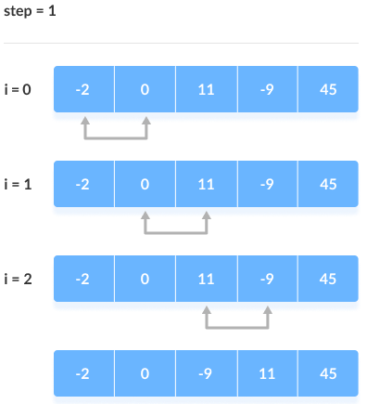
Bubble Sort

Slide 13
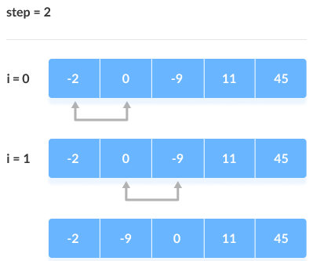
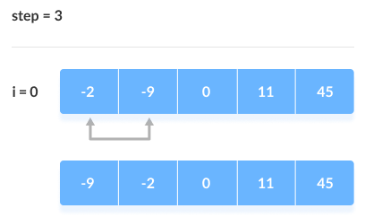
Bubble Sort

